Slide 1
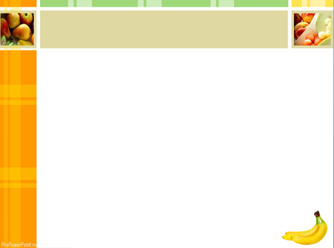
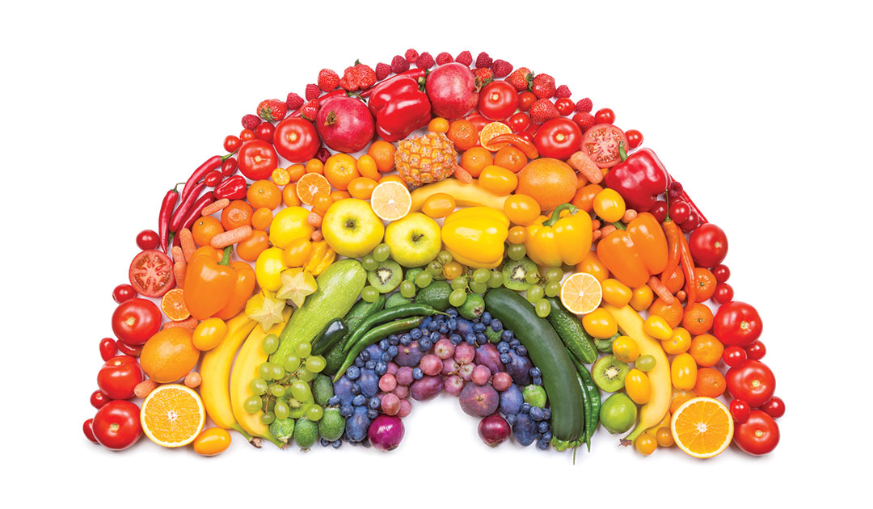
Food

Slide 2
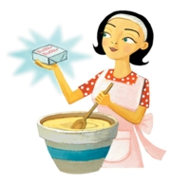
Betty Botta bought some butter,
“But, she said, this butter’s bitter,
But a bit of better butter will make my batter better”.
So, she bought a bit of butter better than the bitter butter,
And it made her batter better.
So, it was batter Betty Botta’s bought a bit of better butter.

Slide 3
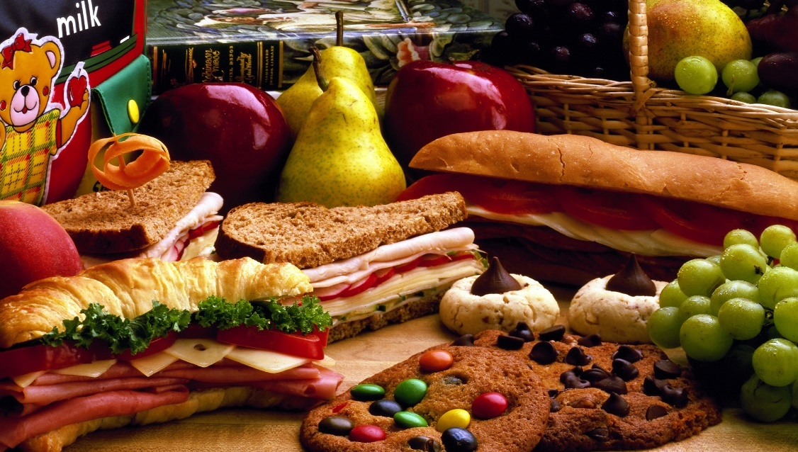
Food means something that people and animals eat, or plants absorb, to keep them alive.

Slide 4
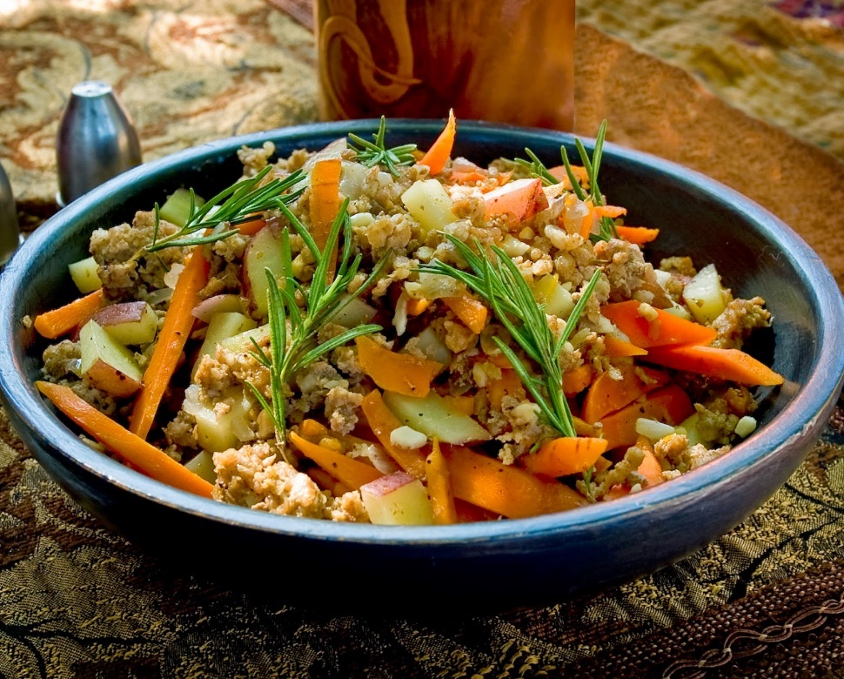
Dish means food prepared in a particular way as part of meal.

Slide 5
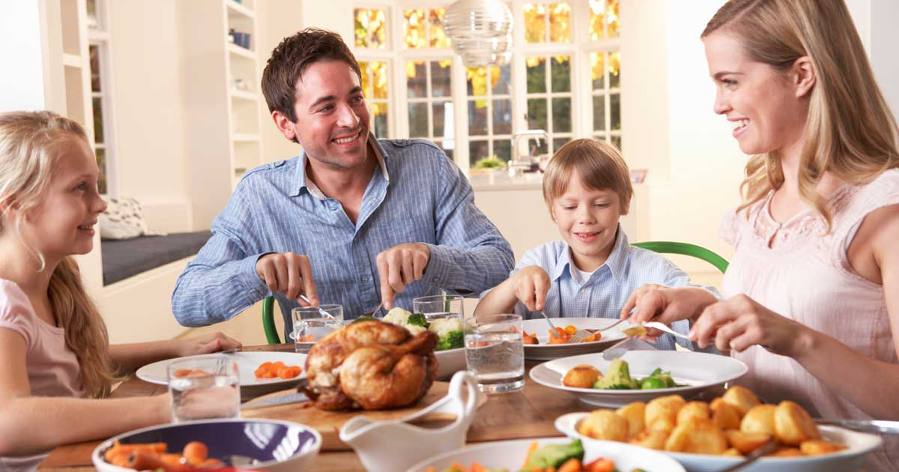
Meal means an occasion when food is eaten, or the food which is eaten on such an occasion.

Slide 6
Fruit | Vegetables
Grape, apple, orange, tomato, cherry, raisin, lemon, melon, strawberry, blueberry, pineapple, peach, pear, raspberry, plum, watermelon, banana, fig, lime | Broccoli, carrot, corn, lettuce, celery, aubergine, pea, pumpkin, cabbage

Slide 7
purple | red
grape plum fig aubergine | apple tomato cherry strawberry raspberry watermelon

Slide 8
green
apple melon pear watermelon lime broccoli lettuce celery pea cabbage

Slide 9
orange | blue | yellow
orange melon peach carrot pumpkin | raisin blueberry | lemon melon pineapple pear banana corn

Slide 10
countable | Uncoun table | Plural forms
grape, apple, orange, tomato, cherry, raisin, lemon, melon, strawberry, blueberry, pineapple, peach, pear, raspberry, plum, watermelon, banana, fig, lime, carrot, lettuce, aubergine, pea, pumpkin, cabbage | Broccoli, corn, celery | grapes, apples, oranges, tomatoes, cherries, raisins, lemons, melons, strawberries, blueberries, pineapples, peaches, pears, raspberries, plums, watermelons, bananas, figs, limes, some broccoli, carrots, some corn, lettuces, some celery, some aubergines, peas, pumpkins, cabbages.

Slide 11
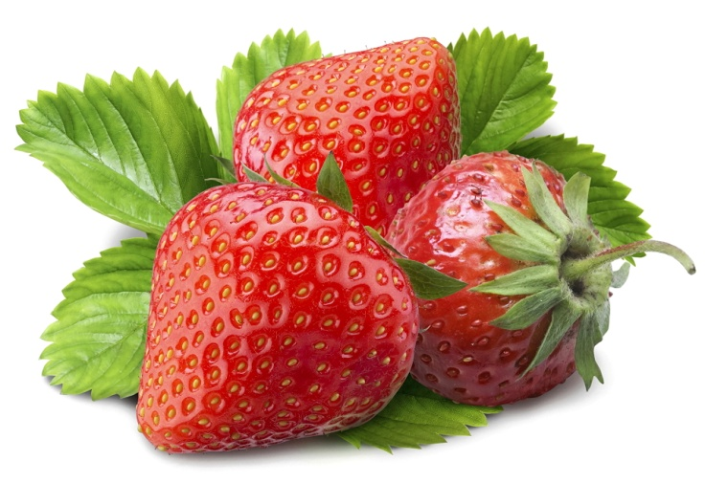
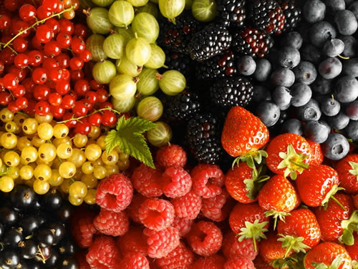
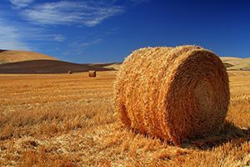
Strawberry — клубника |
Straw — солома, мелкий, berry — ягода

Slide 12
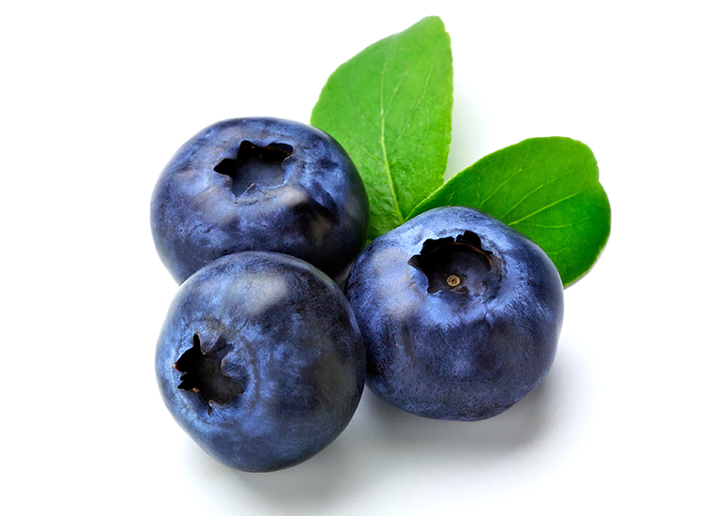

Blueberry — черника |
Blue — синий, berry — ягода

Slide 13
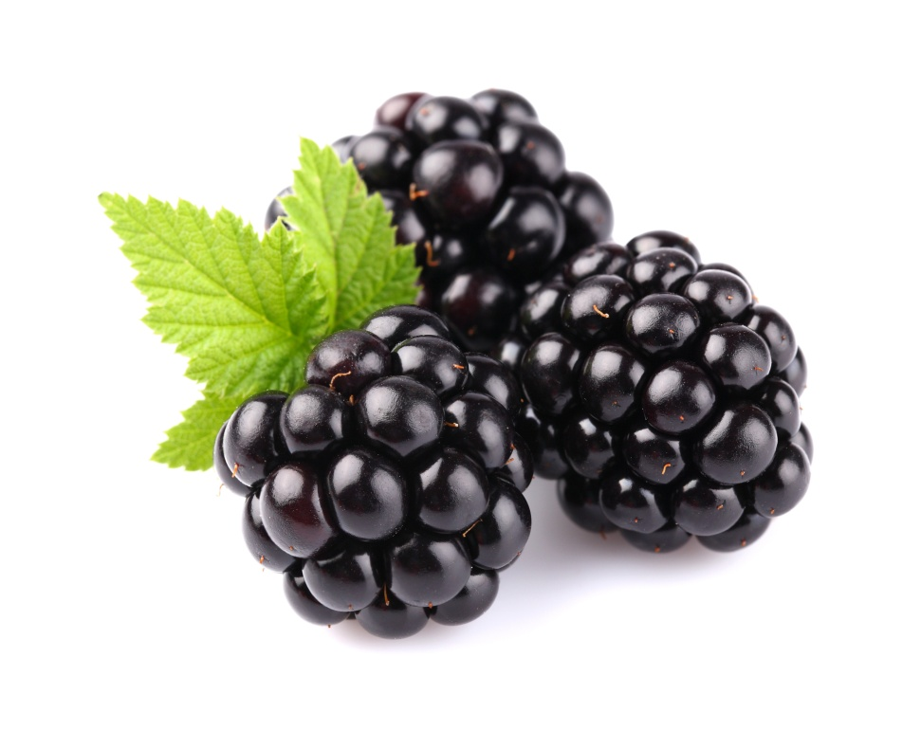

Blackberry — ежевика |
Black — чёрный, berry — ягода

Slide 14
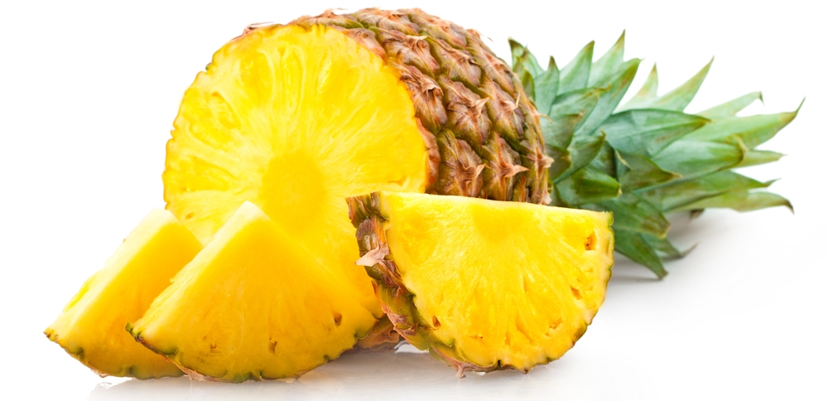
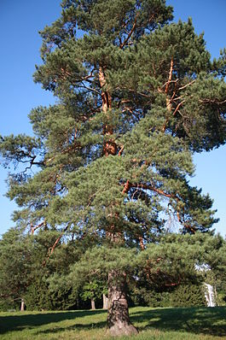
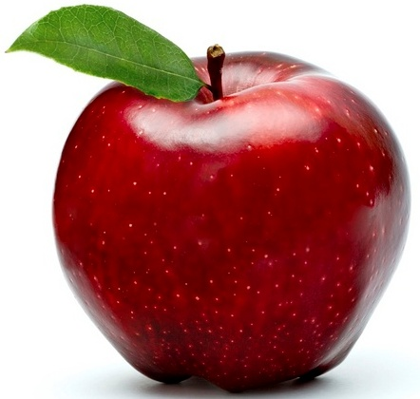
Pineapple — ананас |
Pine — сосна, apple — яблоко

Slide 15
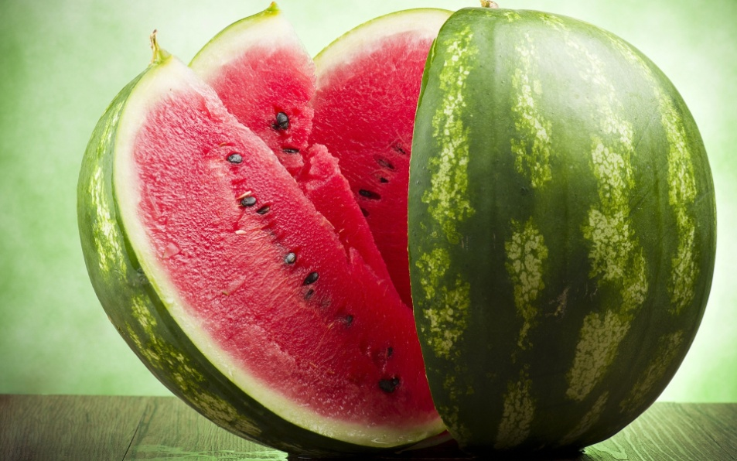
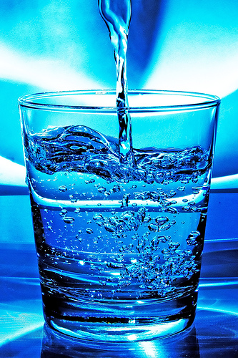
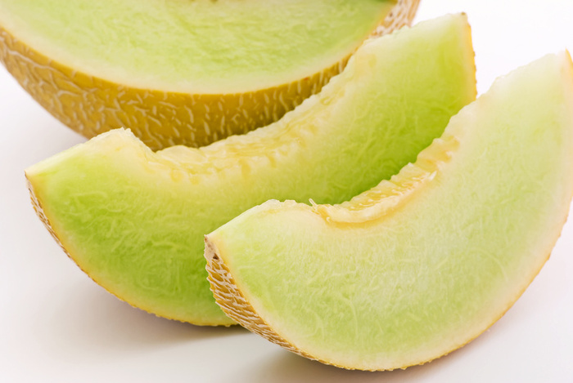
Watermelon — арбуз |
Water — вода, melon — дыня

Slide 16
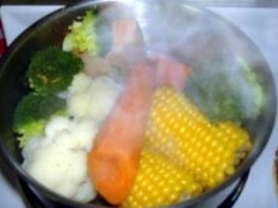
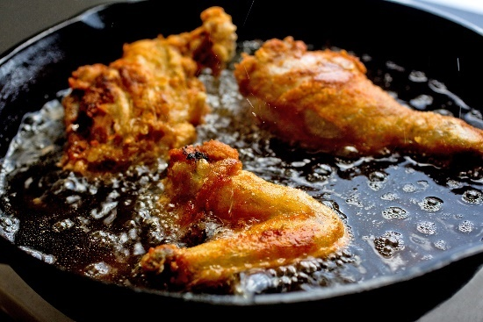
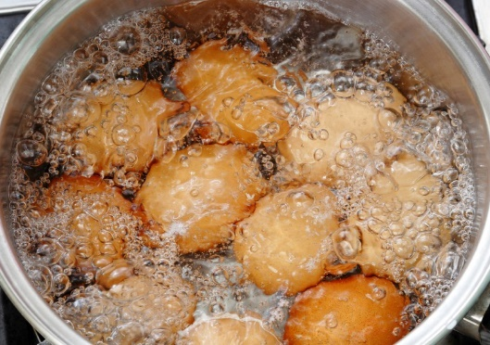
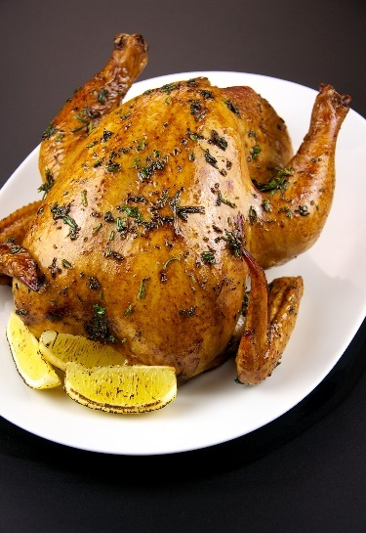
steamed | Cooking methods
fried
boiled
roasted

Slide 17
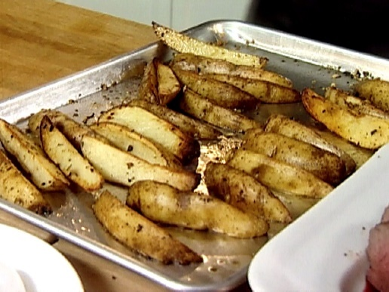
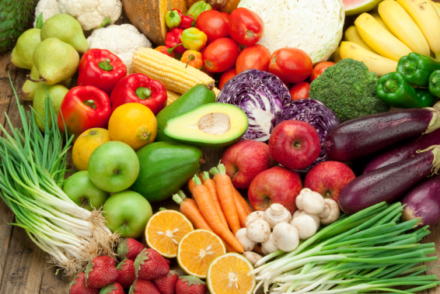
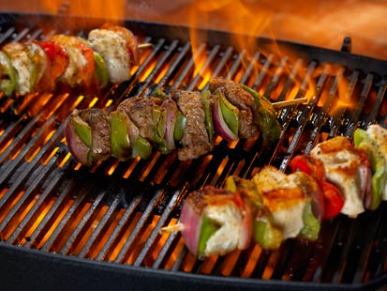
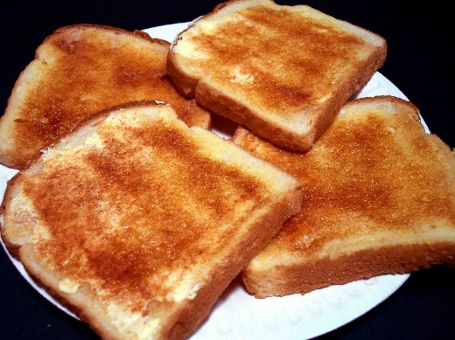
baked
raw
grilled
toasted

Slide 18
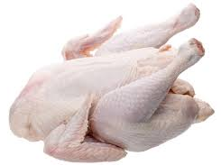
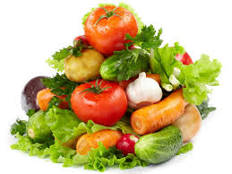
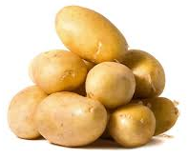
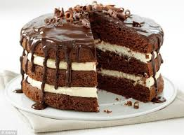
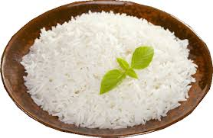
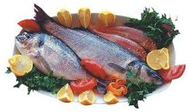
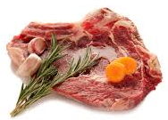
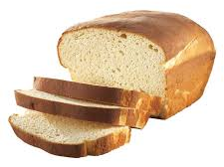
I prefer …

Slide 19
you have a difficult exam to study for? Orange
you are feeling very nervous about meeting someone? Green
you are worried about getting lines and wrinkles? Purple
you’ve been feeling a bit sad lately? Yellow
you are taking part in a championship swimming match? red

Slide 20
Find the verbs/phrases which mean:
1. Eat or buy sth you really enjoy = treat yourself
2. Get rid of = fight of
3. Depressed and miserable = down in the dumps
4. Smiling broadly = frimming from ear to ear
5. Looking for = in a search of

Slide 21

RICH IN | HIGH AMOUNTS FOUND IN
Vitamins, minerals, fibre
Protein
Carbohydrates

Slide 22
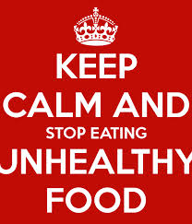
RICH IN | HIGH AMOUNTS FOUND IN
Sugar, fat

Slide 23
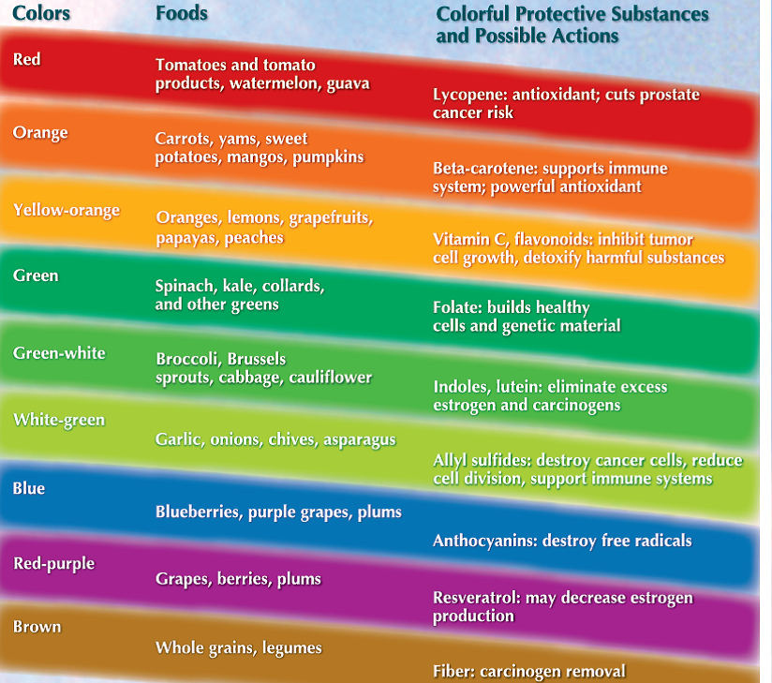

Slide 24
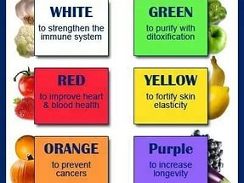

Slide 25
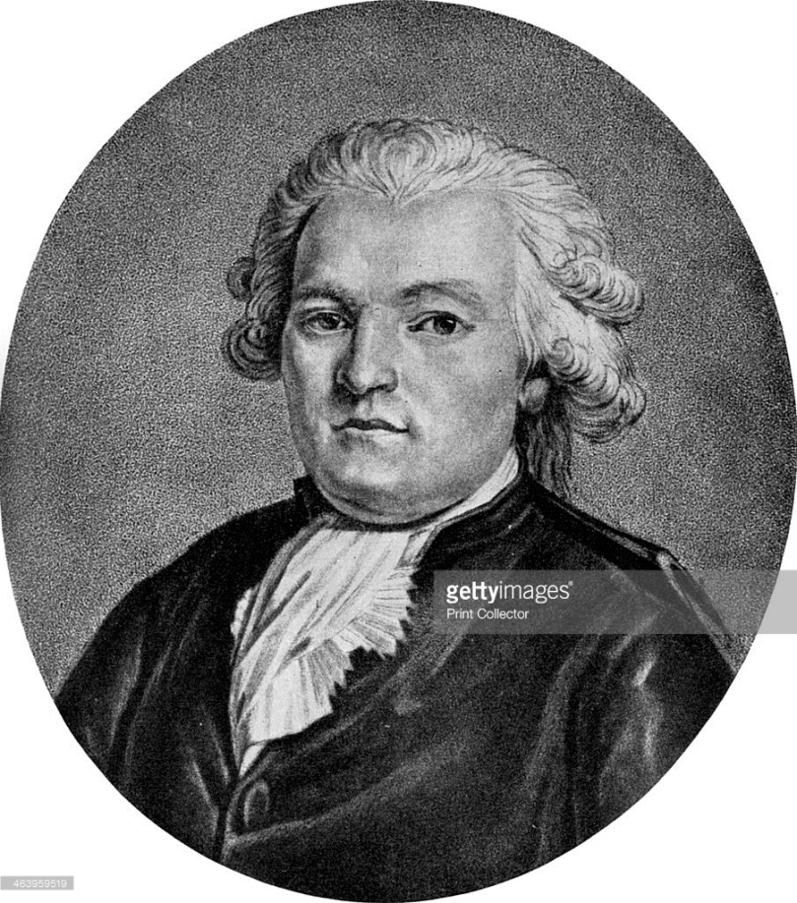
Tell me what you eat,
and I’ll tell you what you are.
(Anthelme Brillat-Savarin,
French lawyer and politician)

Slide 26

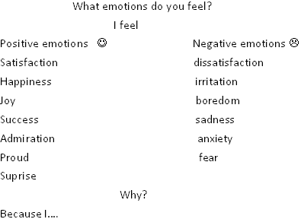

Slide 27
